Slide 1


FoodSwipe
Presentation 2025
Pitch
Presentation

Slide 2

Foodswipe
Presentation 2025
Agenda
Hook + problem
Solution
UVP
Businessmodel
Future improvements
Results & team
CTA/ closing
Pitch Presention

Slide 3
Foodswipe
Page 1
Hook + Problem
People want to eat something new, but get lost in endless lists, reviews, and delivery apps.
• Lack of visual inspiration
• Hard to discover local hidden gems
• Cooking at home takes time because you need to search for recipes
• No platform that combines the best of dining out and cooking at home
Pitch Presention

Slide 4
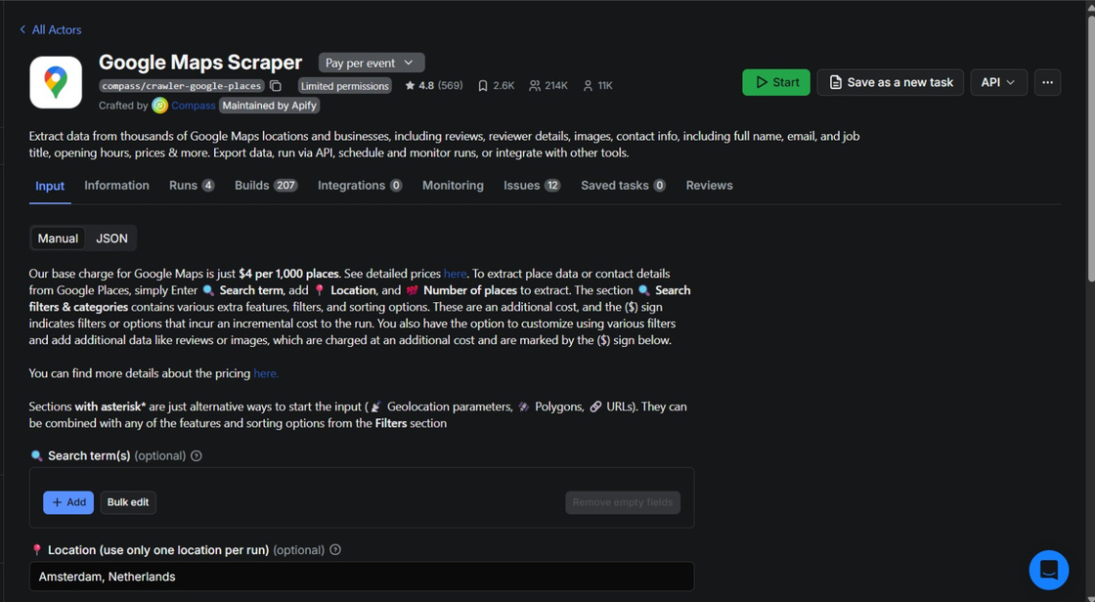

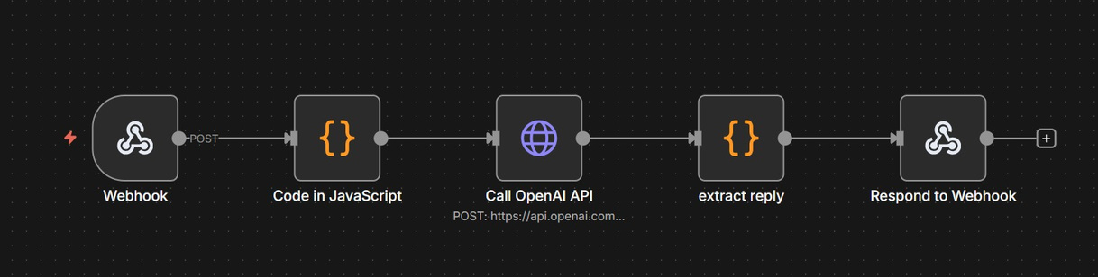
Foodswipe
Page 2
Solution
FoodSwipe: the video-first app that makes discovering food super fast, fun, and personalized.
• TikTok-style swipe feed with local food videos
• Order, reserve, or save dishes instantly
• AI cooking assistant that generates recipes based on your ingredients
• Personalized AI recommendations based on your taste profile and location
Pitch Presention

Slide 5
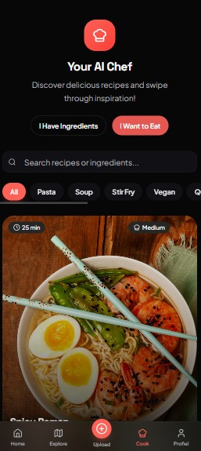
Foodswipe
Page 3
UVP (Unique Value Proposition)
The only app in the world that combines restaurant discovery, delivery actions, and AI-powered cooking.
What makes FoodSwipe unique?
• Video-first → higher conversion & more inspiration
• Hyperlocal discovery → only relevant spots in your neighborhood
• Instant actions → order, reserve, or open the location directly
• AI chef → recipes generated from the ingredients in your fridge
• One platform for every “food mood”: dining out, ordering in, or cooking at home
Pitch Presention

Slide 6
Foodswipe
Page 4
Businessmodel
Multiple revenue streams ensure scalability and stability.
Restaurant Subscriptions (B2B)
• €12.50/month — boosted visibility, analytics, featured badge, reservation integrations
Commissions
• Via Thuisbezorgd/UberEats/Resengo (orders & reservations)
User Premiums (€2.99/month)
• Extra filters, AI coach, premium recipes, ad-free experience
Influencer Partnerships
• Branded content & affiliate deals
Pitch Presention

Slide 7
Foodswipe
Page 5
Future Improvements
1. Camera ingredient recognition
“Soon, you’ll be able to recognize ingredients just by using your camera.”
2. Supermarket integration
“Add ingredients directly to your supermarket cart.”
3. Direct Thuisbezorgd ordering
“Ordering via Thuisbezorgd will soon be possible directly inside FoodSwipe.”
4. Video upload → AI generates recipe
“Upload a cooking video… and our AI instantly creates the full recipe.”
Pitch Presention

Slide 8
Foodswipe
Page 6
Results & Team
Traction potential (projections from your plan):
• In 1 city within 6 months: €12,000–€15,000 revenue per month
• Strong network effects driven by food creators and restaurants
• Video-first content leads to higher engagement
Team:
• Visionary product team
• Strong expertise in AI, mobile development, and integrations (n8n, APIs)
Pitch Presention

Slide 9
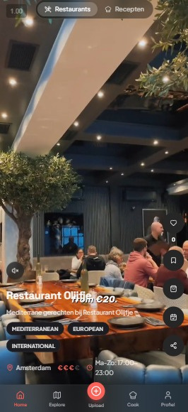
Foodswipe
Page 7
CTA / Closing
FoodSwipe wordt de super-app voor alles rondom eten.
Van een viral foodvideo → naar direct bestellen, reserveren of zelf koken met AI.
Wij bouwen hét platform dat miljoenen dagelijkse eetkeuzes makkelijker maakt.
Pitch Presention

Slide 10

Foodswipe
Thank You!
Join the waitlist!

